Slide 1
Expert Systems

Slide 2
Goals of AI
To Implement Human Intelligence in Machines
− Creating systems that understand, think, learn, and behave like humans.
To Create Expert Systems
− The systems which exhibit intelligent behavior, learn, demonstrate, explain, and advice its users.

Slide 3
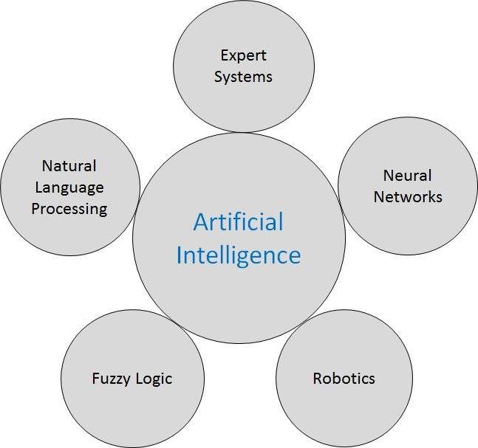
Branches of AI

Slide 4
Data
Collection of raw facts
Information
Processed data
Knowledge
Is the awareness and understanding of data and information
Intelligence
Is the ability to acquire, understand and apply knowledge

Slide 5
Definition
An expert system is software that attempts to reproduce the performance of one or more human experts, most commonly in a specific problem domain.
Represent the expertise knowledge as data or rules within the computer
Can be called upon when needed to solve problems

Slide 6
Capabilities of Expert Systems
Advising
Instructing and assisting human in decision making
Demonstrating
Deriving a solution
Diagnosing
Explaining
Predicting results
Justifying the conclusion
Suggesting alternative options to a problem

Slide 7
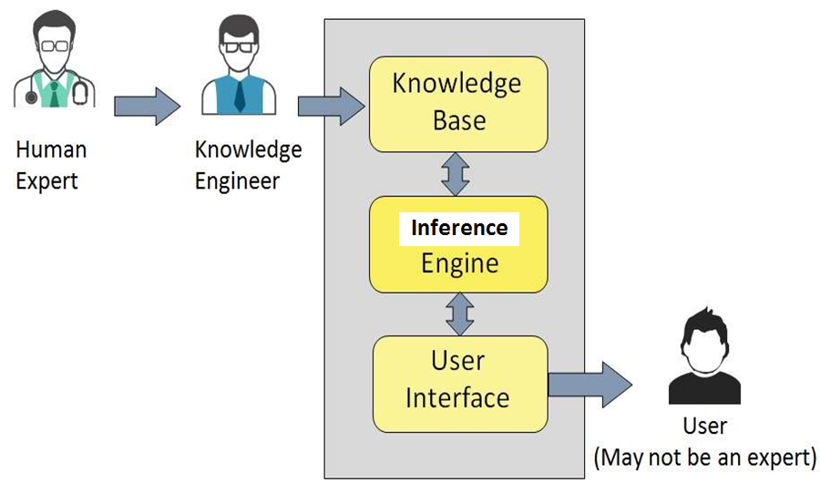
Components of Expert Systems

Slide 8
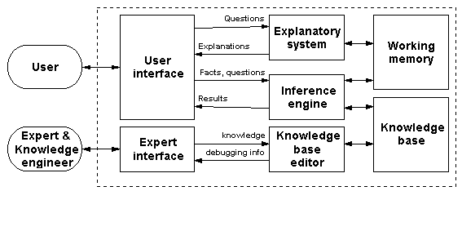
Architecture of an Expert System

Slide 9
Knowledge base
Factual Knowledge − It is the information widely accepted by the Knowledge Engineers and scholars in the task domain.
Heuristic Knowledge − It is about practice, accurate judgement, one’s ability of evaluation, and guessing.
Knowledge representation
IT-THEN-ELSE rules
Knowledge acquisition
Readings from various experts, scholars, and the Knowledge Engineers.
Knowledge engineer
A person with the qualities of empathy, quick learning, and case analyzing skills

Slide 10
Inference Engine
Knowledge-based ES
Inference Engine acquires and manipulates the knowledge from the knowledge base
Rule based ES
Inference Engine Applies rules repeatedly to the facts
Adds new knowledge into the knowledge base if required.
Resolves rules conflict when multiple rules are applicable to a particular case.

Slide 11
Inference Engine…
To recommend a solution, the Inference engine uses the following strategies
Forward Chaining
Backward Chaining

Slide 12
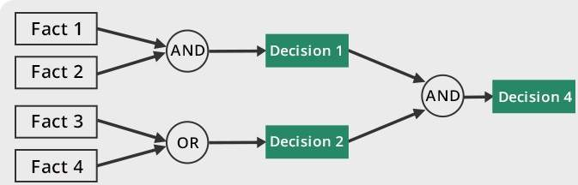
Forward Chaining
“What can happen next?”

Slide 13
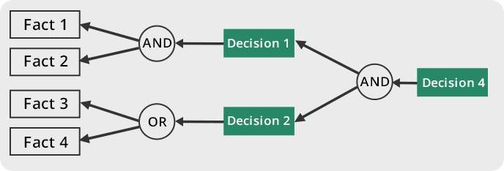
Backward Chaining
“Why this happened?”

Slide 14
User Interface
User interface provides interaction between user and ES
It explains how the ES has arrived at a particular recommendation in the following forms
Natural language displayed on screen.
Verbal narrations in natural language.
Listing of rule numbers displayed on the screen.

Slide 15

Knowledge Acquisition Facility
Knowledge acquisition facility
Provides a convenient and efficient means of capturing and storing all components of the knowledge base
Knowledge base
Knowledge acquisition facility

Slide 16
Shell
Shells come equipped with an inference mechanism
Require knowledge to be entered according to a specified format
Other features
Tools for writing hypertext
Constructing friendly user interfaces, for manipulating lists, strings, and objects, and for interfacing with external programs and databases

Slide 17
Shells − A shell is nothing but an expert system without knowledge base. A shell provides the developers with knowledge acquisition, inference engine, user interface, and explanation facility. For example, few shells are given below −
Java Expert System Shell (JESS) that provides fully developed Java API for creating an expert system.
Vidwan, a shell developed at the National Centre for Software Technology, Mumbai in 1993. It enables knowledge encoding in the form of IF-THEN rules.

Slide 18
Expert Systems Development
Determining requirements
Identifying experts
Construct expert system components
Implementing results
Domain
The area of knowledge addressed by the expert system.
Maintaining and reviewing system

Slide 19
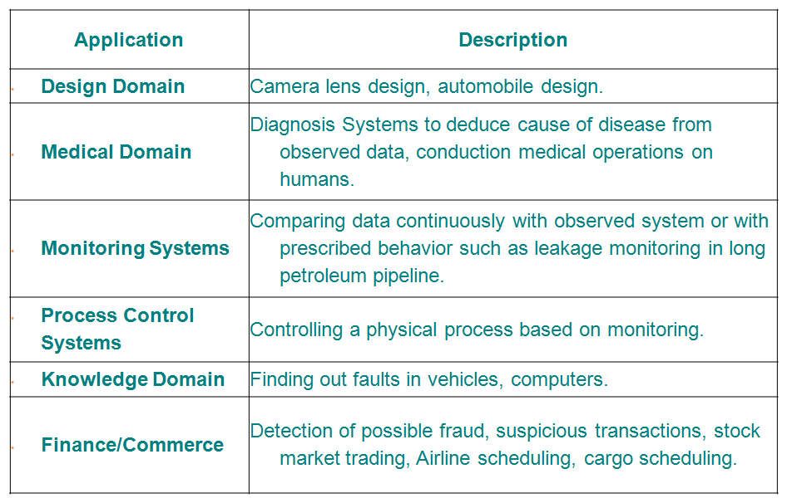
Applications of Expert Systems

Slide 20
Advantages
Consistent answers for repetitive decisions, processes and tasks
Holds and maintains significant levels of information
Encourages organizations to clarify the logic of their decision-making
Never "forgets" to ask a question, as a human might

Slide 21
Disadvantages
Lacks common sense
Cannot make creative responses as human expert
Domain experts not always able to explain their logic and reasoning
Errors may occur in the knowledge base
Cannot adapt to changing environments

Slide 22
